Slide 1

ENTERPRISE NW DESIGN – LUIS RIVERA
GROUP C – (BATCH-2024)
Shaik Reshma Fathima
Sindhu Anugula
Sailaxmi Kalwa
Neelima Kommareddy
Sai Sri Harsha Pemmasani
Venkat Rajulpati

Slide 2
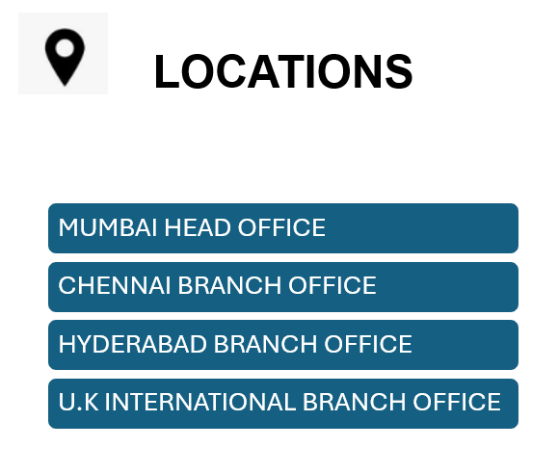
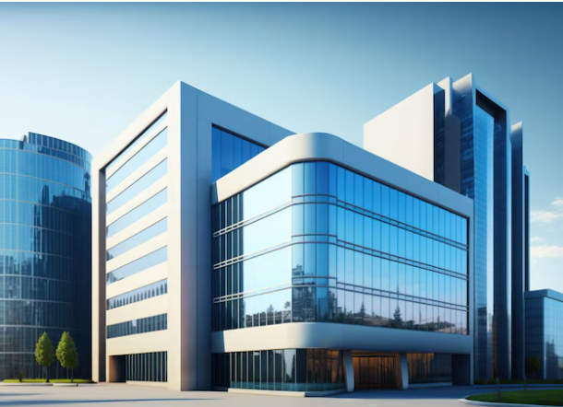
SUBANI IT SOLUTIONS ☺

Slide 3


BUSINESS GOALS
SUBANI IT SOLUTIONS is a fast-growing IT SERVICE company. Which offers IT solutions and services to its clients. The company is located in MUMBAI (HEAD OFFICE), CHENNAI (Branch 1), HYDERABAD (Branch 2) and U.K (International Branch). The company is serving various Projects over the locations hosting IT-Support (30), VEREZON (200), MAX-LIFE (100), MICROSOFT(50), AWS (120), PnC (250), APT-ONLINE (150), ITC (45).
Due to security requirements, it has been decided that all LAN, WLAN, and VoIP users will be on a separate network segment within the same local area network. The firewall will be used to set security zones and filter traffic that moves in and out of the zones based on the configured inspection policies.

Slide 4

REQUIREMENTS & TECHNICAL GOALS
Cisco Packet Tracer
Cisco ASA Firewall
ISP
WLC
VoIP
VLAN, Subnetting , Inter-VLAN Routing
EtherChannel
DHCP Server
Telephony Service
Standard ACL for SSH

Slide 5

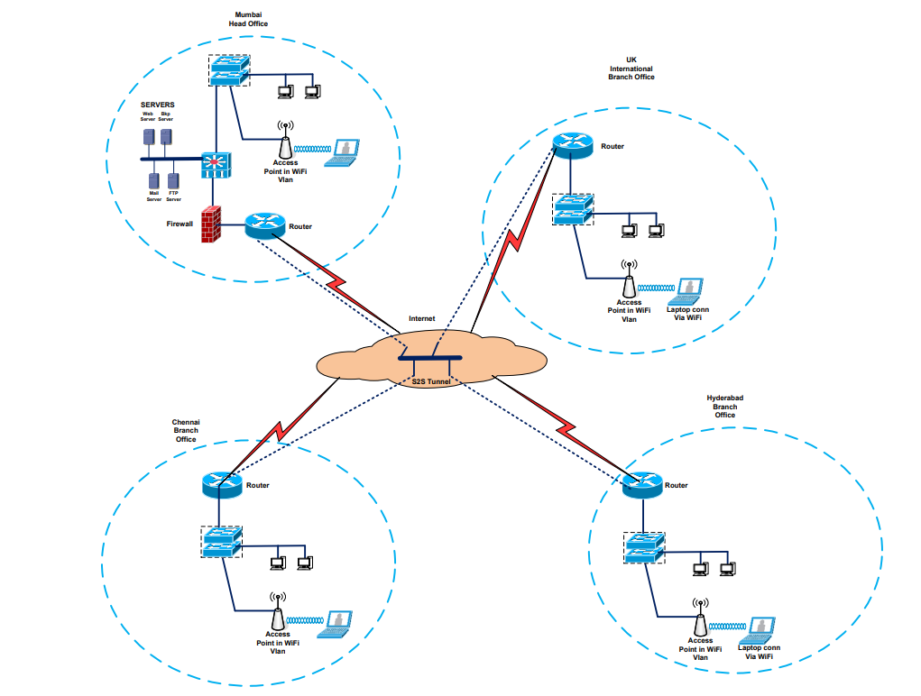
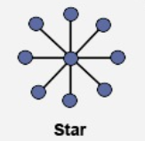
NW INFRASTRUCTURE OVERVIEW
NETWORK TOPOLOGY

Slide 6

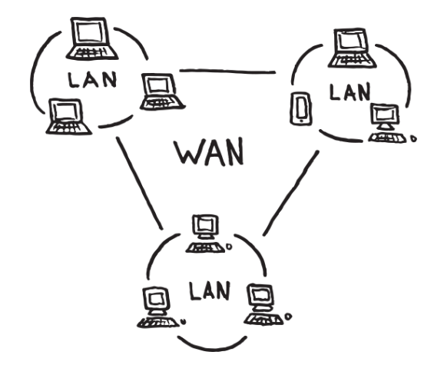




SERVICES PROVIDED
LAN
WAN
VOICE TELEPHONY
WIRELESS
EMAIL-SERVICE
FTP-SERVER
WEB-SERVER
PRINTER

Slide 7

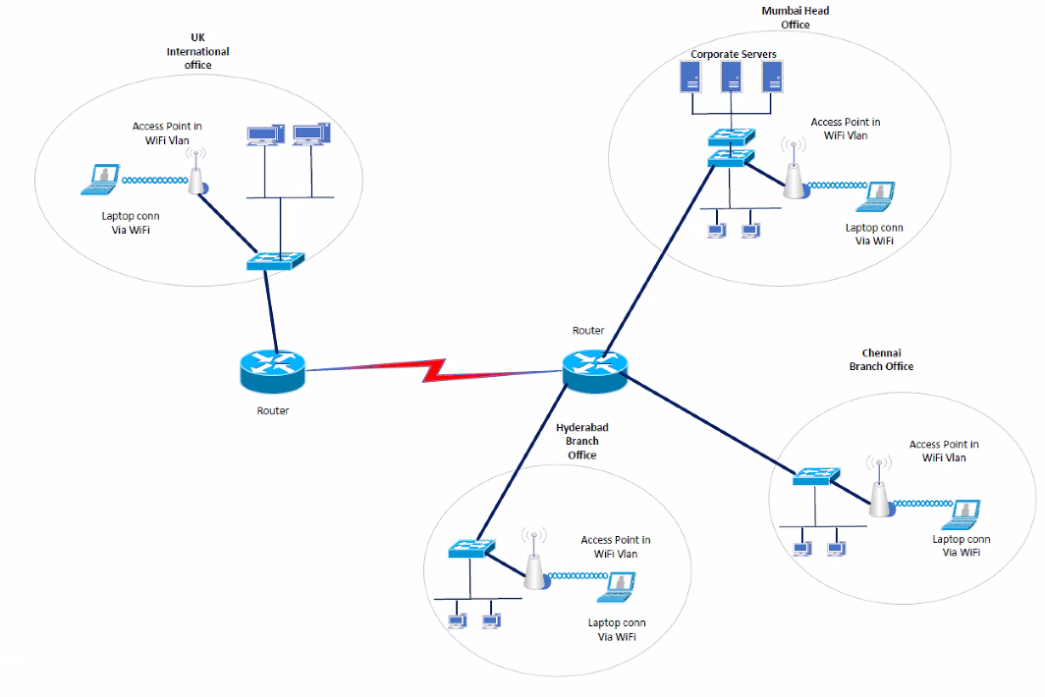
PRESENT NETWORK DIAGRAM

Slide 8
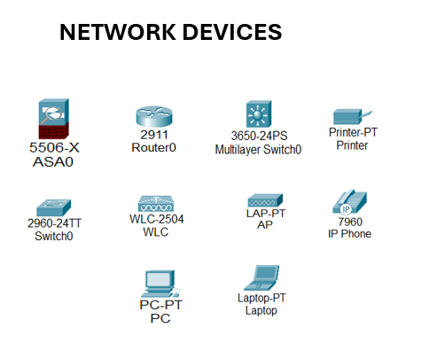
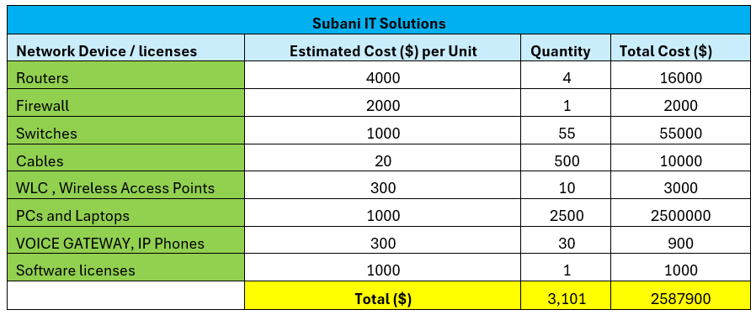
BRIEF LIST OF DEVICES
DEVICES BUDGET

Slide 9
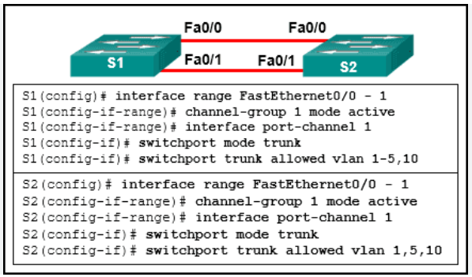
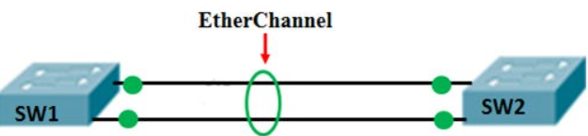
ETHER-CHANNELING
SWITCH CONFIGURATION
SWITCH CONNECTION
EtherChannel combines Ethernet links into one, increasing bandwidth and improving network reliability and efficiency.

Slide 10
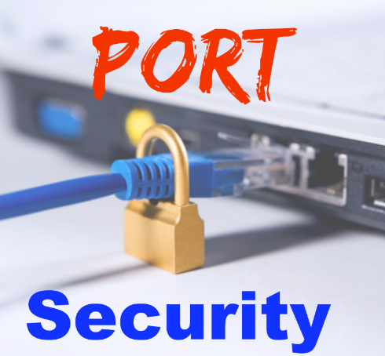
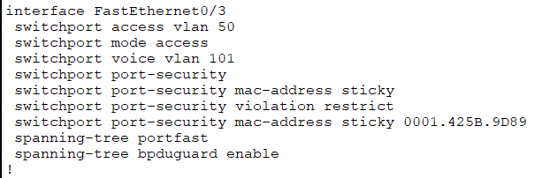
SWITCH PORT SECURITY
MAC-BINDING
Basic Configuration

Slide 11
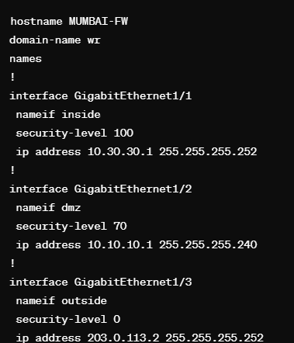
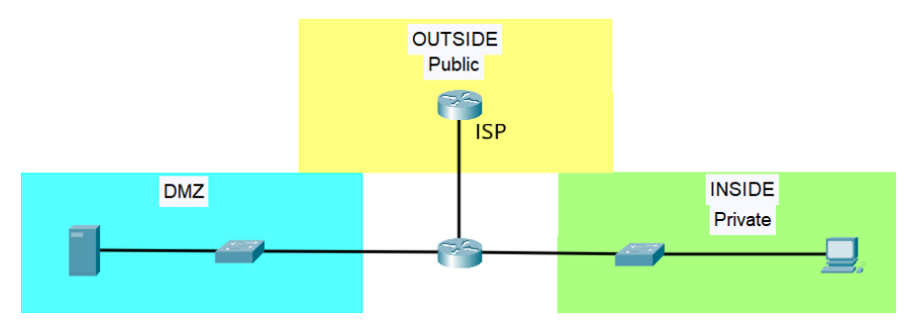
FIREWALL ZONES CONFIGURATION
OUTSIDE-INSIDE-DMZ ZONES
FW ZONES OVERVIEW

Slide 12
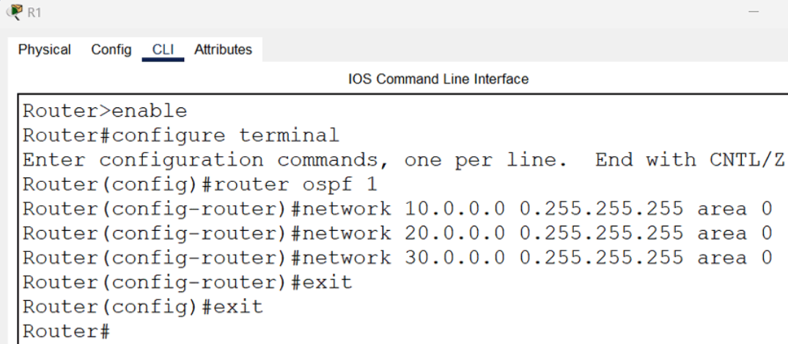
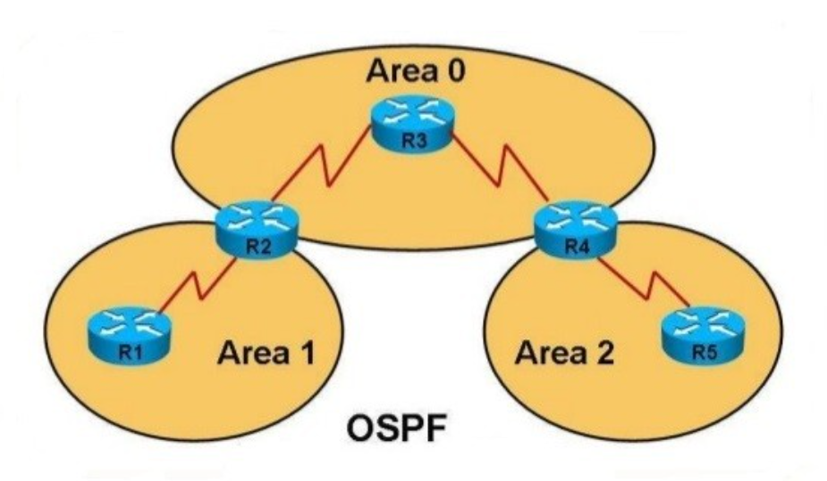
OSPF ROUTING PROTOCOL
OVERVIEW
BASIC COMMANDS
OSPF is a link-state routing protocol used in IP networks to determine the best paths for routing IP packets.

Slide 13
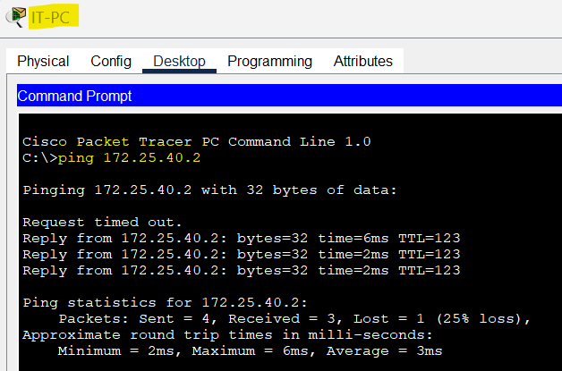
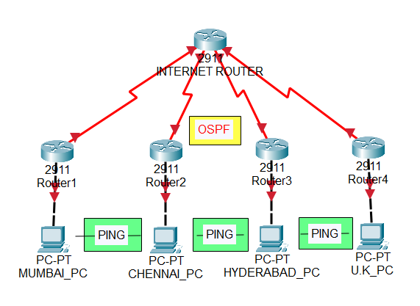
OSPF IMPLEMENTATION
PING CHECK SUCCESSFULL
U.K_PC IP : 172.25.40.2 TO MUM_PC IP : 172.25.9.11

Slide 14
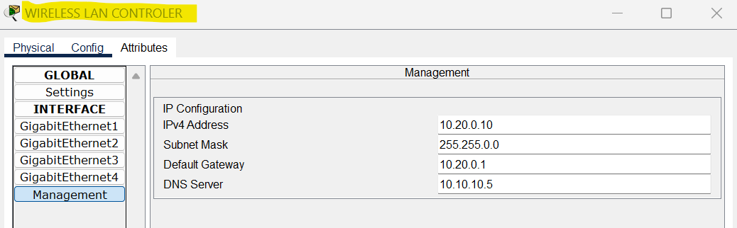
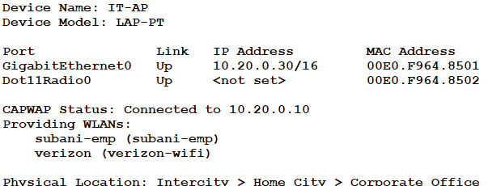
WIRELESS LAN CONTROLLER (WLC)
WLC MGMT CONFIGURATION
AP GETTING IP FROM WLC

Slide 15
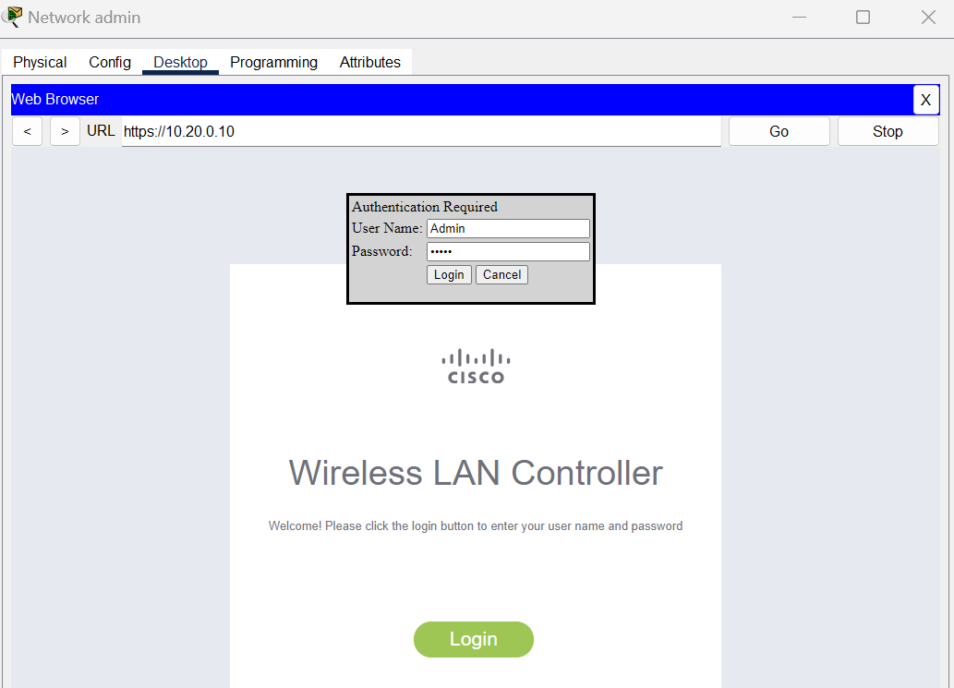
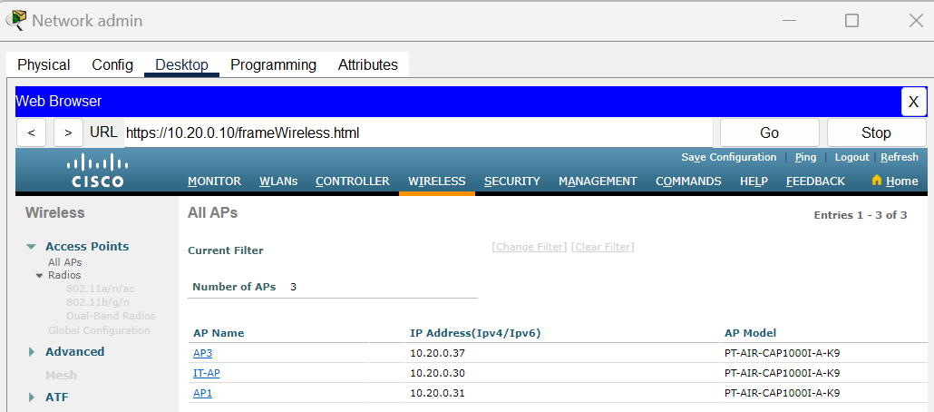
NW ADMIN CONTROLLING WLC
WLC LOGIN PAGE
LIST OF ACCESS POINTS

Slide 16

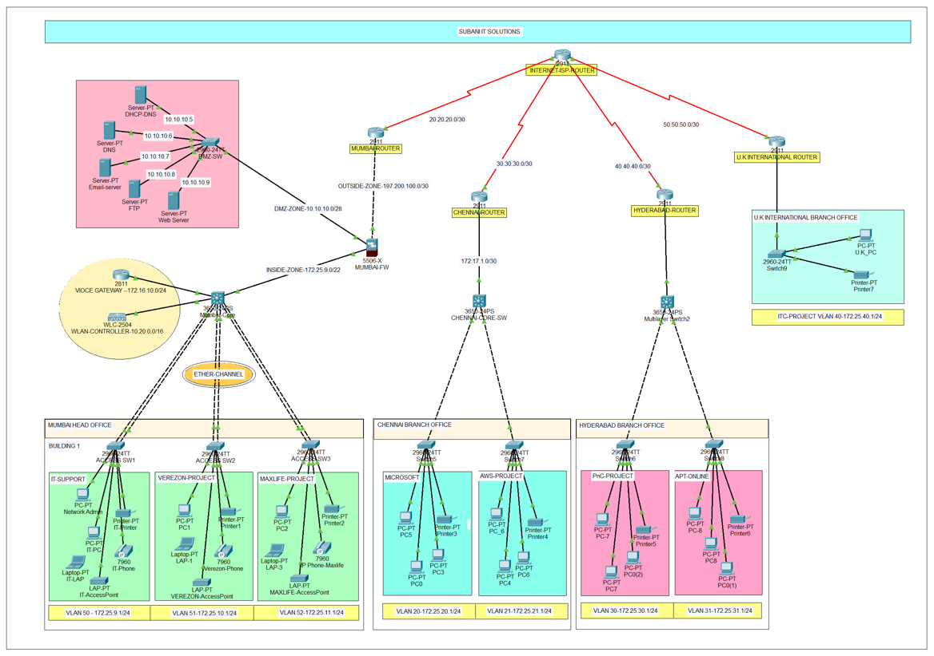
PROPOSED NETWORK DIAGRAM

Slide 17
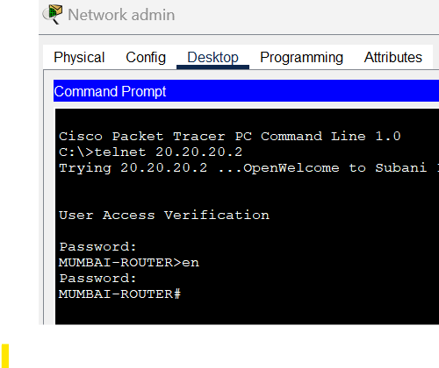
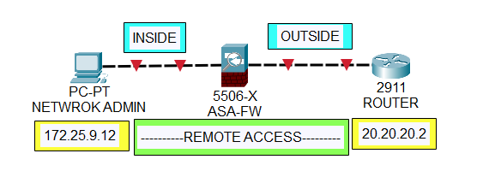
NETWORK ADMIN SSH ACCESS
SSH IMPLEMENTATION
SSH
REMOTE ACCESS

Slide 18
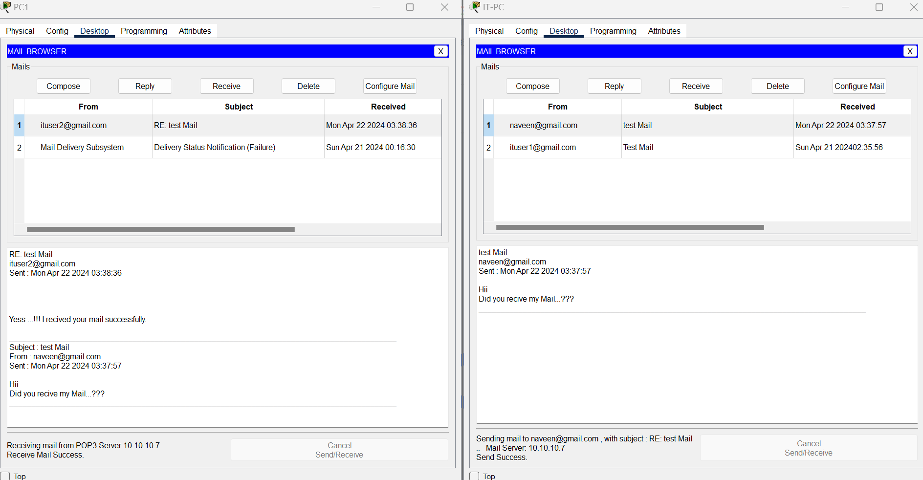
EMAIL SERVICE

Slide 19
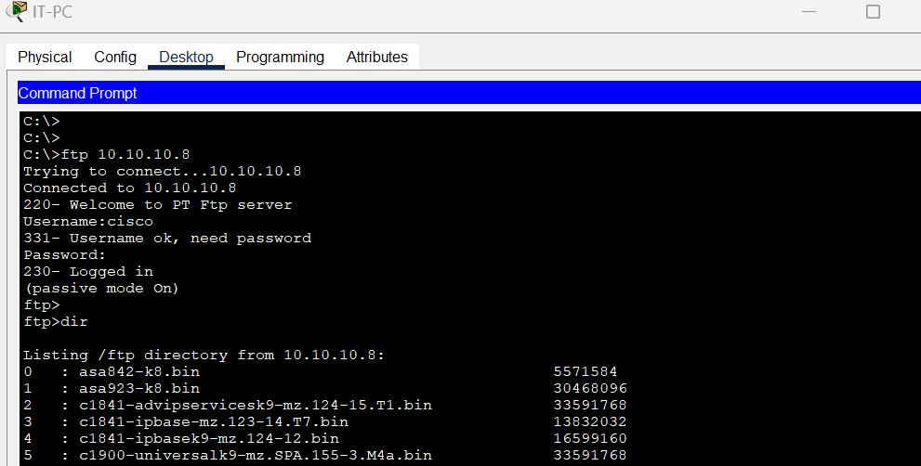
FTP SERVICE

Slide 20
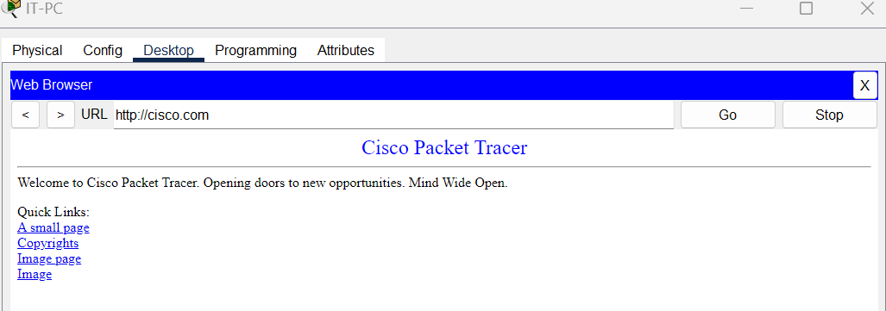
WEB SERVICE

Slide 21
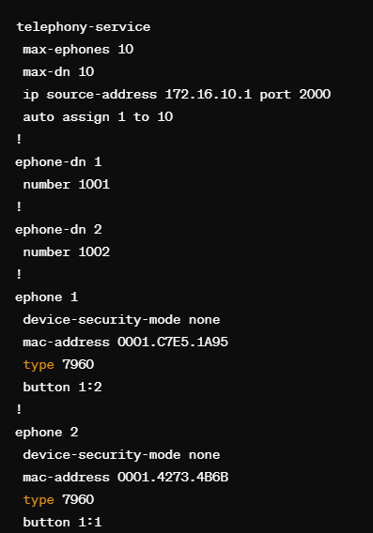
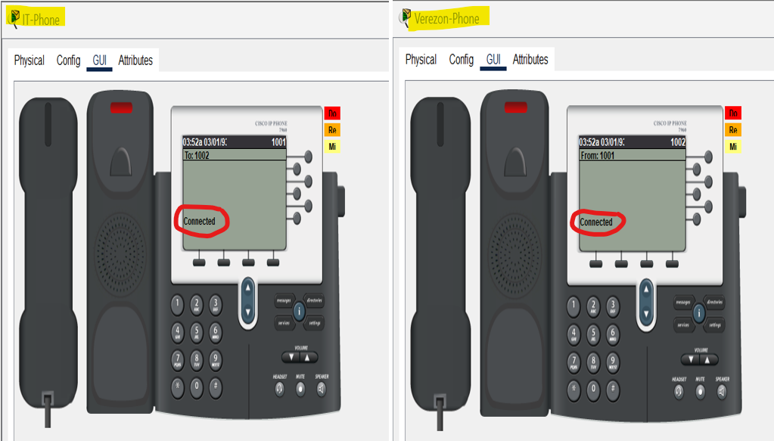
VOICE TELEPHONY IMPLEMENTATION
IP PHONE CONNECTION

Slide 22

THANK YOU..!!
OPEN FOR QUESTIONS (estoy aquí para ayudarte!)

